Slide 1
DAR ES SALAAM SCHOOL OF JOURNALISM
MODULE NAME: LIFE SKILLS
MODULE CODE:GST 05105
DEPARTMENT :JOURNALISM
MODULE LEVEL:5
MODULE SEMESTER: I
TUTOR’S NAME:AYUBU GAMBA
OUR MOTTOR: MEDIA FOR DEMOCRACY

Slide 2
THIS MODULE CONSIST OF THREE (3) TOPICS:
TOPIC 1
Environmental issues
TOPIC 2
Personal hygiene and heath living behaviour
TOPIC 3
Population management.

Slide 3
TOPIC 1:ENVIRONMENTAL ISSUES
What is Environment?
The term environment has been derived from a French word “Environia” means to surround. It refers to both abiotic (physical or non-living) and biotic (living) environment. So
Environment means The sum total of all surroundings of a living organism, including natural forces and other living things, which provide conditions for development and growth as well as of danger and damage. See also environmental factors
COMPONENTS OF ENVIRONMENT:
Environment mainly consists of
atmosphere,
hydrosphere,
Lithosphere
biosphere

Slide 4
Continued…
TYPES OF ENVIRONMENT
There are two different types of environment:
Geographical Environment
Man-made Environment
Geographical Environment
It consists of all components provided by nature and hence can be called as the natural environment. It is also referred to as the physical environment as it pertains to the physical requirements of life. These physical or geographic conditions are not dependent on the existence of humans. Sometimes, humans have no control over the physical conditions of the environment.
It includes natural resources, the earth’s surface, mountains, plains, land, water, deserts, storms, cyclones, volcanoes, oceans, climatic factors, and so on. It is also used to refer to biological situations such as complexities associated with plants and animals. The sustainability of the natural resources is known to contribute towards the economy of a country.
Man-Made Environment
This environment is used to refer to the one created by man in order to regulate and monitor certain environmental conditions. Some address it as a social-cultural environment. It can further be divided into two types of environments.

Slide 5
Inner Environment
Outer Environment
The Inner Environment
It is a social environment and it exists as long as a particular society exists. It pertains to the regulations, traditions, organizations and institutions. It involves customs and folkways which is existent in every human group. It is addressed with names such as non-material culture, social heritage etc. This heritage is essential for the social life of humans to flourish, it is known to have an influence on an individual’s life. The altered forms of the economic and physical environment – artificial environment, are seen as two different aspects of the man-made environment.
The Outer Environment
Through advancement in the field of science and technology, humans have attempted to alter conditions of their physical environment. This outer environment is as a result of these modifications which includes modern infrastructure in cities, our homes and their associated amenities, our modes of communication and transport, our resorts to conveniences and luxury, different kinds of industry manufacturing luxurious commodities, electrical appliances and so on which ultimately aims at civilization and urbanization.

Slide 6
KEY BASIS OF ENVIRONMENT PROBLEMS
What is climate change?
Climate change is a change in the pattern of weather, and related changes in oceans, land surfaces and ice sheets, occurring over time scales of decades or longer
Weather is the state of the atmosphere—its temperature, humidity, wind, rainfall and so on—over hours to weeks. It is influenced by the oceans, land surfaces and ice sheets, which together with the atmosphere form what is called the ‘climate system’. Climate, in its broadest sense, is the statistical description of the state of the climate system.
Climate change is a change in the statistical properties of the climate system that persists for several decades or longer—usually at least 30 years. These statistical properties include averages, variability and extremes. Climate change may be due to natural processes, such as changes in the Sun’s radiation, volcanoes or internal variability in the climate system, or due to human influences such as changes in the composition of the atmosphere or land use.
Weather can be forecast with considerable skill up to about a week in advance. Short term fluctuations in climate, such as droughts, can be predicted with limited skill from season to season. In contrast, changes in the long-term statistics of the climate system (climate change) can be predicted if caused by long-term influences that are known or predictable

Slide 7
Global warming
is the ongoing rise of the average temperature of the Earth's climate system and has been demonstrated by direct temperature measurements and by measurements of various effects of the warming. It is a major aspect of climate change which, in addition to rising global surface temperatures, also includes its effects, such as changes in precipitation. While there have been prehistoric periods of global warming, observed changes since the mid-20th century have been record in rate and scale.
The ozone layer or ozone shield is a region of Earth's stratosphere that absorbs most of the Sun's ultraviolet radiation. It contains high concentration of ozone (O₃) in relation to other parts of the atmosphere, although still small in relation to other gases in the stratosphere. The ozone layer contains less than 10 parts per million of ozone, while the average ozone concentration in Earth's atmosphere as a whole is about 0.3 parts per million. The ozone layer is mainly found in the lower portion of the stratosphere, from approximately 15 to 35 kilometers (9.3 to 21.7 mi) above Earth, although its thickness varies seasonally and geographically.

Slide 8
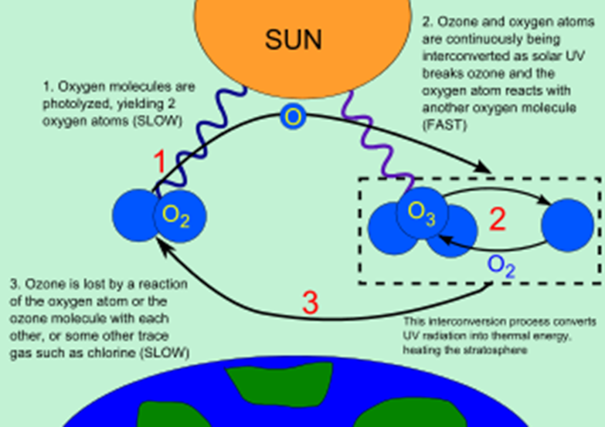
(continued...)

Slide 9
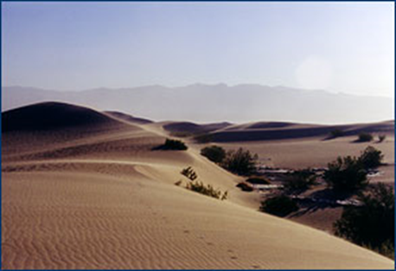
Desertification
is a type of land degradation in dry lands in which biological productivity is lost due to natural processes or induced by human activities whereby fertile areas become increasingly more arid. It is the spread of arid areas caused by a variety of factors, such as through climate change (particularly the current global warming) and through the overexploitation of soil through human activity.
When deserts appear automatically over the natural course of a planet's life cycle, then it can be called a natural phenomenon; however, when deserts emerge due to the rampant and unchecked depletion of nutrients in soil that are essential for it to remain arable, then a virtual "soil death" can be spoken of, which traces its cause back to human overexploitation. Desertification is a significant global ecological and environmental problem with far reaching consequences on socio-economic and political conditions.
Sahara desert in Africa around eleven countries

Slide 10
assignment
Why environmental ?

Slide 12
Any Question?

Slide 13
CONTACT TUTOR IN CHARGE
Full name: AYUBU C. GAMBA
Department: JOURNALISM
Email Address: agamba133@gmail.com
Phone number: 0769055073

